Slide 1

Analog and Digital Integrated Circuits

Slide 2
Unit IV Converters

Slide 3
Lesson Plan
Topic | Sub points | Book-Page Nos.
DAC –specs | Definitions | Salivahanan
Types of DAC ,Advantages & Disadvantages | Binary Weighted, R to R Ladder | Salivahanan
ADC-specs | Definitions | Salivahanan
Types of ADC- Advantages & Disadvantages | Flash, SAR | Salivahanan
Numericals
Notes:
T1: Fourth Edition, Ramakant Gayakwad, “Op-Amps and Linear Integrated Circuits”

Slide 7
DAC Specifications

Slide 8
DAC Specifications

Slide 9
DAC Specifications

Slide 11
Purpose
To convert digital values to analog voltages
Performs inverse operation of the Analog-to-Digital Converter (ADC)
Reference Voltage
DAC
Digital Value
Analog Voltage

Slide 12
DACs
Types
Binary Weighted Resistor
R-2R Ladder
Multiplier DAC
The reference voltage is constant and is set by the manufacturer.
Non-Multiplier DAC
The reference voltage can be changed during operation.
Characteristics
Comprised of switches, op-amps, and resistors
Provides resistance inversely proportion to significance of bit

Slide 13
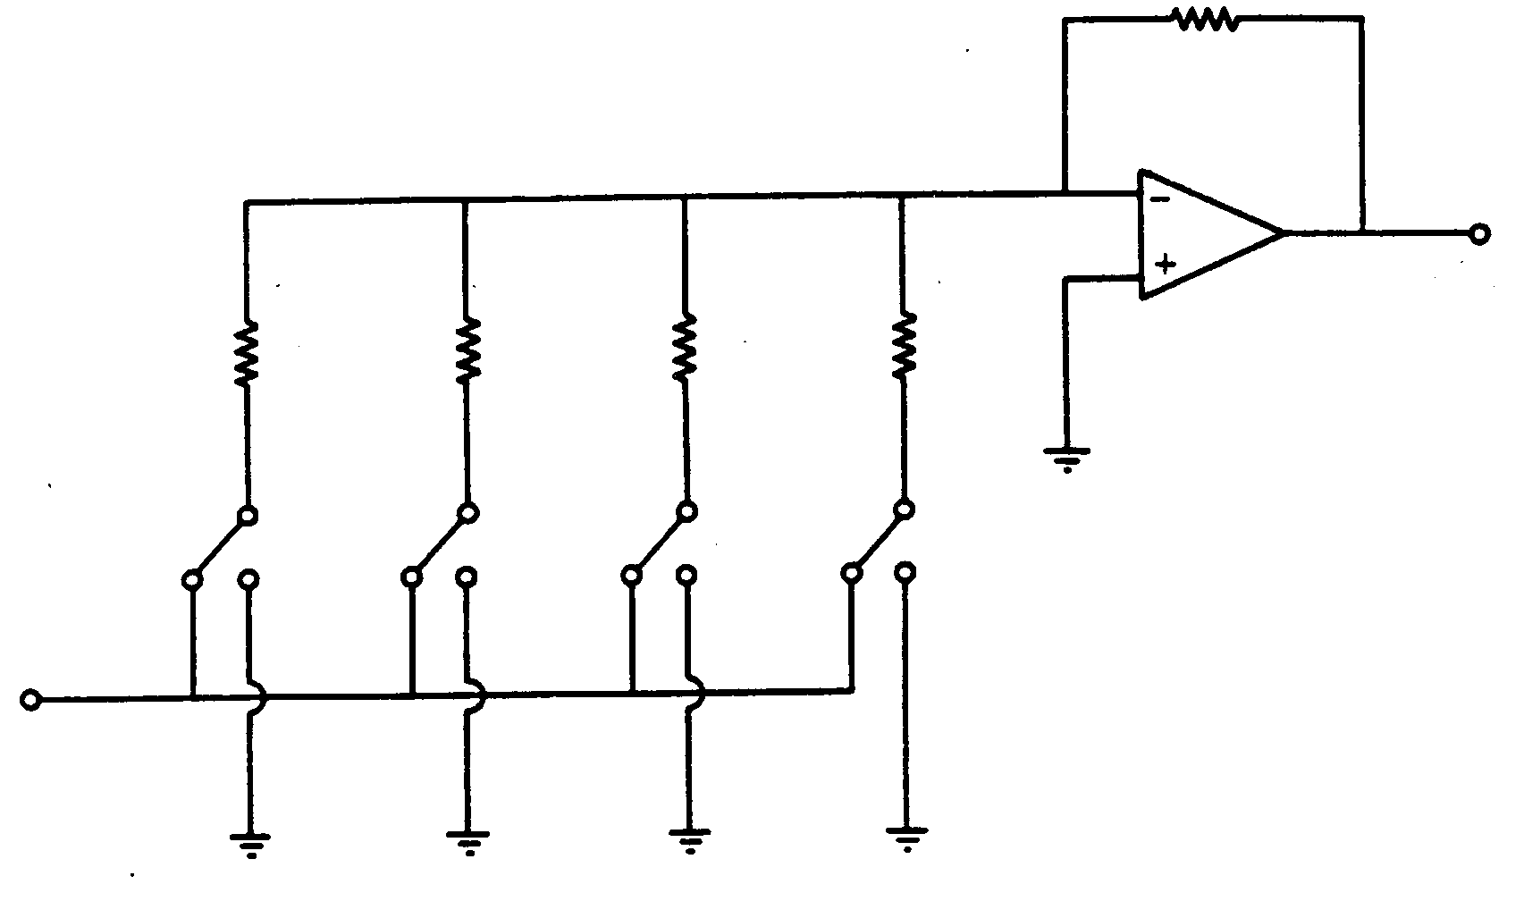
Binary Weighted Resistor
R_{f} = R
R
2R
4R
8R
V_{o}
MSB
LSB
-V_{REF}

Slide 14
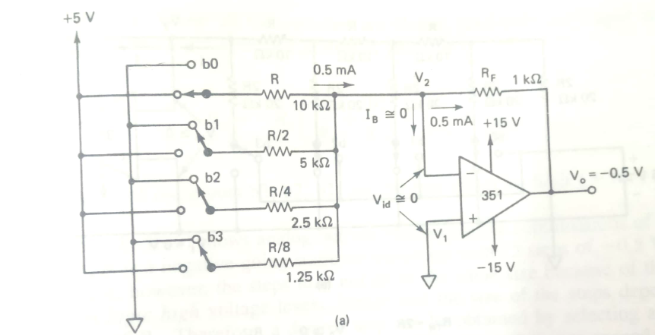
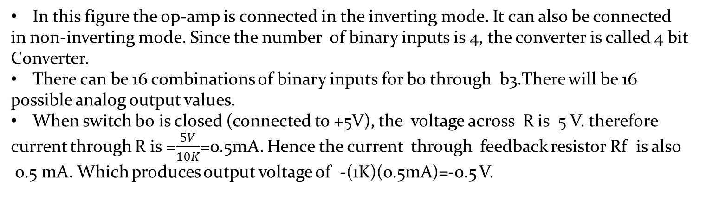
D/A Converter with binary –weighted resistors EXAMPLE CIRCUIT FROM
Gayakwad WITH VALUES
In this figure the op-amp is connected in the inverting mode. It can also be connected
in non-inverting mode. Since the number of binary inputs is 4, the converter is called 4 bit
Converter.
There can be 16 combinations of binary inputs for b0 through b3.There will be 16
possible analog output values.
When switch b0 is closed (connected to +5V), the voltage across R is 5 V. therefore
current through R is =$\frac{5V}{10K}$=0.5mA. Hence the current through feedback resistor Rf is also
0.5 mA. Which produces output voltage of -(1K)(0.5mA)=-0.5 V.

Slide 15
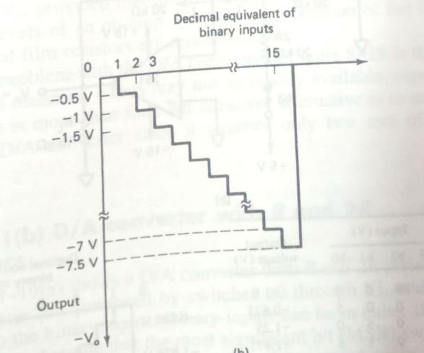
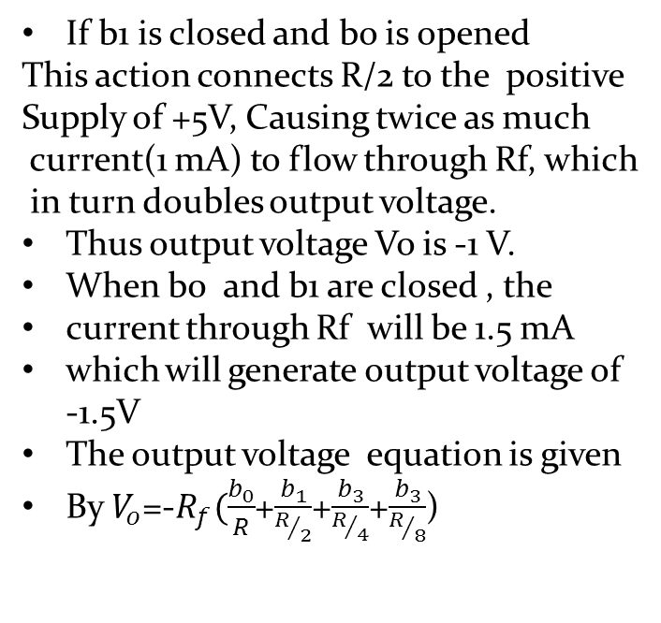
If b1 is closed and bo is opened
This action connects R/2 to the positive
Supply of +5V, Causing twice as much
current(1 mA) to flow through Rf, which
in turn doubles output voltage.
Thus output voltage Vo is -1 V.
When b0 and b1 are closed , the
current through Rf will be 1.5 mA
which will generate output voltage of
-1.5V
The output voltage equation is given
By $V_{o}$=-$R_{f}(\frac{b_{0}}{R}$+$\frac{b_{1}}{R/2}$+$\frac{b_{3}}{R/4}$+$\frac{b_{3}}{R/8}$)
Disadvantage: Requires weighted resistors

Slide 20
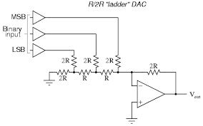
R-2R 3 bit DAC

Slide 22
Voltage Mode R-2R Ladder

Slide 23
Pros & Cons
 | Binary Weighted | R-2R
Pros | Easily understood | Only 2 resistor values Easier implementation Easier to manufacture Faster response time
Cons | Limited to ~ 8 bits Large # of resistors Susceptible to noise Expensive Greater Error | More confusing analysis

Slide 24
A/D Converters
It converts an analog signal into its equivalent n-bit binary coded digital output signal.
The analog input is sampled at a frequency much higher than the maximum frequency component of the input signal.
ADC accepts an analog input Vi and produces an output binary word b1,b2,….bn of fractional value D
D= b1 2⁻¹ + b2 2⁻² +………+ bn 2^{-n}
where, b1 is the MSB and bn is the LSB.

Slide 25
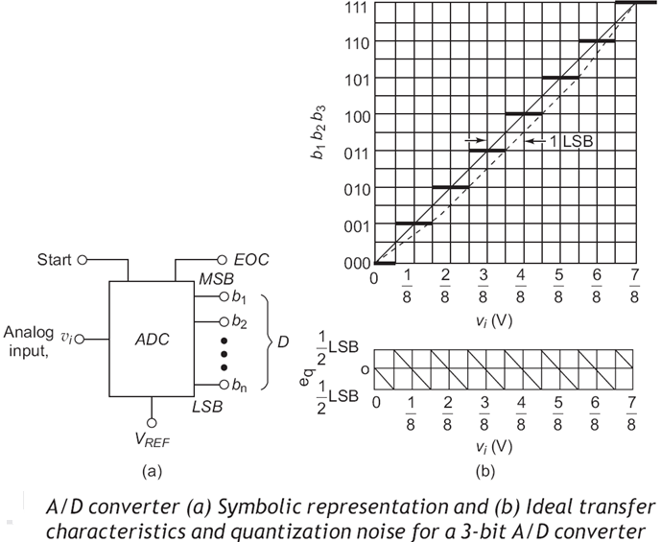
A/D Converters contd….
Fig a shows symbolic representation of ADC
Fig b shows the ideal characteristics of 3bit A/D converter with full-scale analog voltage V_{FS}=1V
ADC process divides the analog input signal into 2^{n} intervals called Code Ranges.
The values Vi falling within the code range are represented by particular code

Slide 26
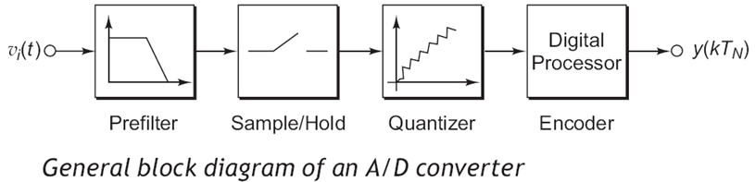
Block Diagram of ADC
It consist of antialiasing filter or prefilter, Sample-and-Hold amplifier , a Quantizer and an Encoder.
Prefilter: avoids the aliasing (misidentification of high frequency signals.
Sample-and-Hold: It holds the input analog signal into the ADC at a constant value during the conversion time.
Quantizer: it segments the reference voltage into the subranges, typically for an n-bit digital output code , there are 2^{n} subranges.
Encoder: The digital processor forms the encoder circuit which encodes the subrange into the corresponding digital bits.
Therefore the analog input signal convert into digital signal within the conversion time.

Slide 27
A/D Converter Applications
Digital Audio: Digital audio workstations, sound recording, pulse-code modulation
Digital signal processing: TV tuner cards, microcontrollers, digital storage oscilloscopes
Scientific instruments: Digital imaging systems, radar systems, temperature sensors

Slide 28

Specifications of Analog to digital Convereter
Resolution: It refers to the finest minimum change n the signal which is accepted for conversion, and it is decided with respect to number of bits.
The resolution of the converter indicates the number of discrete values it can produce over the range of analog values.
Resolution = 1/2^{n} , where n is the number of digital output word bits.
The digital output starts at 0 for the ADC, therefore the maximum full scale input voltage which will cause the output to be all logic 1_{s} is 1LSB less than full-scale voltage range .

Slide 29


An 8-bit A/D converter accepts an input voltage signal of range 0 to 10 V. (a) What is the minimum value of the input voltage required to generate a change of 1 LSB? (b) What input voltage will generate all 1s at the A/D converter output? (c) What is the digital output for an input voltage of 4.8 V?
Solution:
(a)
(b)
viFS = 10V – 39.1 mV = 9.961 V.
(c) The digital output for an applied input voltage of 4.8V is given by
Converting this to binary gives the digital output for an 8-bit A/D converter to be 01111011

Slide 30
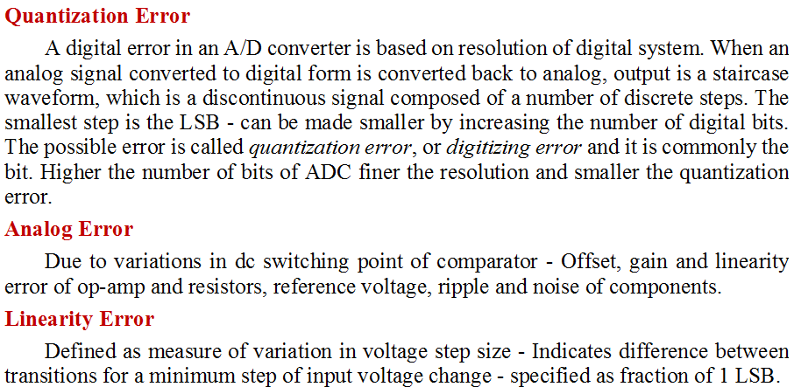
Specification of ADC Converter contd…

Slide 31
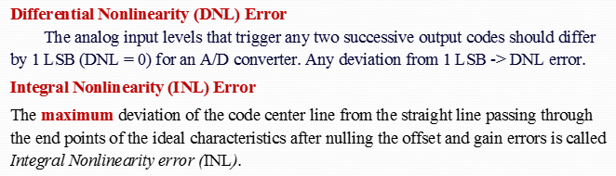
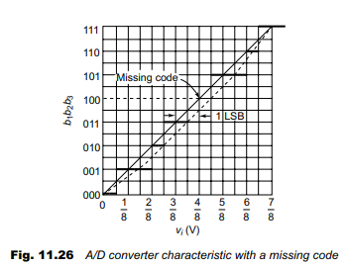
Specification of ADC Converter contd…
Ideal characteristics
Code centre line
(actual input step voltage ranges)

Slide 32
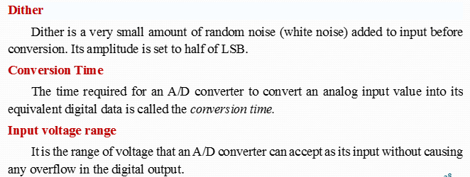
The performance of ADC can be improved using Dither.

Slide 34
Based on operation of conversion
Flash type/ Simultaneous (parallel)
Successive approximation
Dual Slope type(Integrator)
Single slope type
Counter type
Tracking or Servo type

Slide 35
Flash ADC
Let’s start design of a 2-bit flash ADC for resolution of 0.25V
Number of OP-Amp Required : 2^{n}-1
The reference voltage required:
Vref = Resolution * 2^{n}
Reference voltage = 0.25*4 = 1V

Slide 36
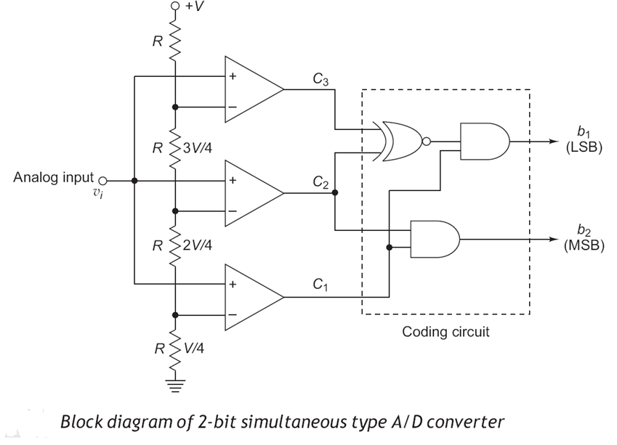
Simultaneous Type (Flash Type) A/D Converter

Slide 37
Uses the 2^N resistors to form a ladder voltage divider, which divides the reference voltage into 2^N equal intervals.
Uses the 2^(N)-1 comparators to determine in which of these 2^N voltage intervals the input voltage Vin lies.
The Combinational logic then translates the information provided by the output of the comparators
This ADC does not require a clock so the conversion time is essentially set by the settling time of the comparators and the
propagation time of the combinational logic.

Slide 38
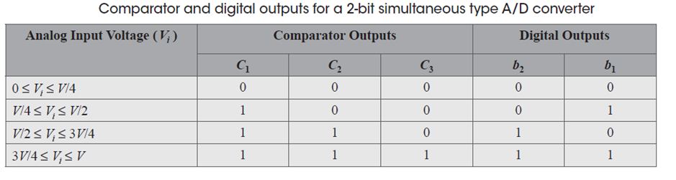
2-bit Flash type ADC

Slide 39
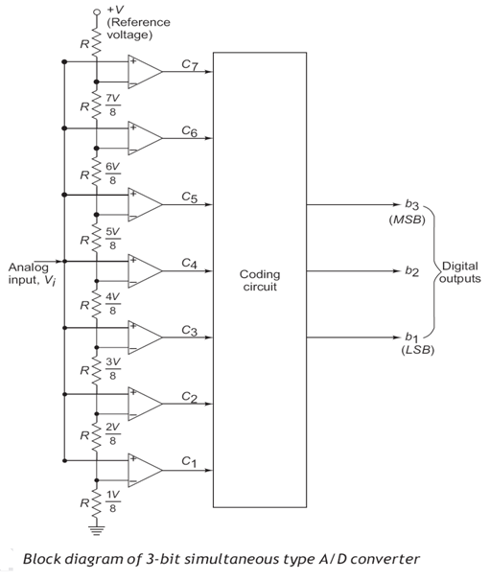
3-bit Flash type ADC

Slide 40
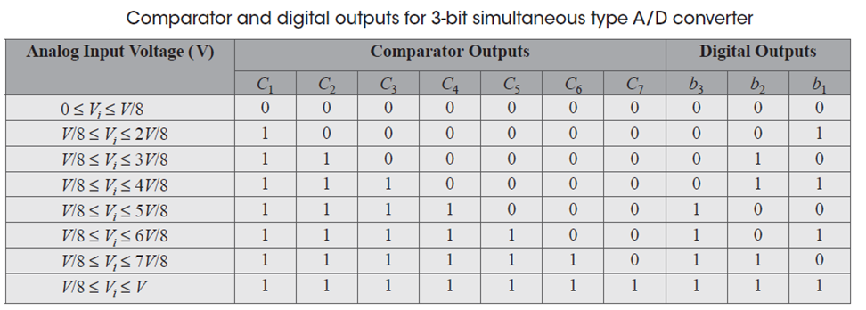
3-bit Flash type ADC

Slide 41
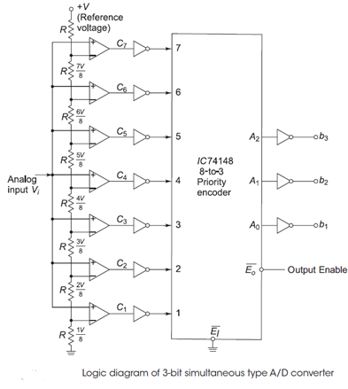
Logic Diagram of 3-bit Flash type ADC

Slide 42
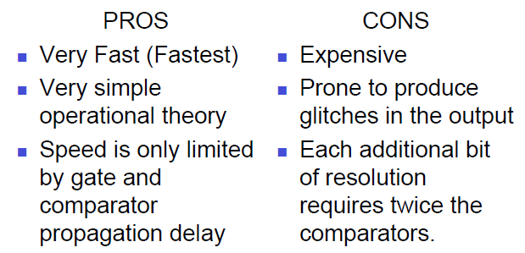
Flash ADC

Slide 43
Flash ADC
Advantages
Flash ADCs are very fast and can convert data at high frequencies.
Disadvantages
The major disadvantage to flash ADCs is the complexity of the circuits.
an 8-bit Flash ADC requires 255 op amps
a 12-bit Flash ADC requires 4095 op amps
a 16-bit flash ADC requires 65,535 op amp
High Cost (Major factor over 6 bits)

Slide 44
Flash ADC
Advantages
(i) Fastest because A/D conversion is performed simultaneously through a set of comparators. Hence, it is also called flash type A/D converter. Typical conversion time is 100ns or less.
(ii) The construction is simple and easier to design.
Disadvantages
Not suitable for A/D conversion with more than 3 or 4 digital output bits. Then 2^(N)-1 comparators are required for an n-bit A/D converter and the number of comparators required doubles for each added bit.

Slide 45
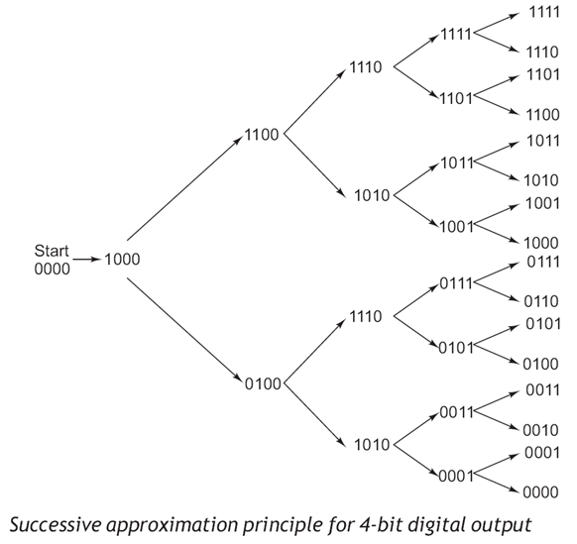
Successive Approximation Type A/D Converter

Slide 46
Successive Approximation Type A/D Converter
Uses a n-bit DAC to compare DAC and original analog results.
•Uses Successive Approximation Register (SAR) supplies an approximate digital code to DAC of Vin.
•Comparison changes digital output to bring it closer to the input value.
•Uses Closed-Loop Feedback Conversion

Slide 47
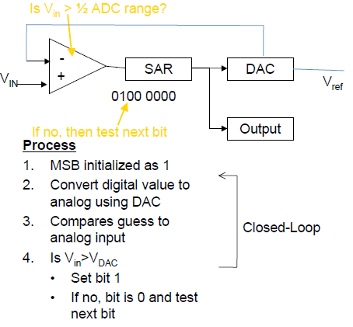
Working of Successive Approximation Type A/D Converter

Slide 48
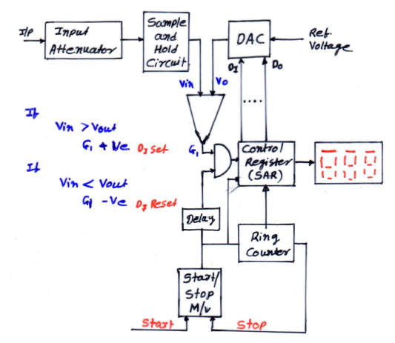
Successive Approximation

Slide 49
Successive Approximation ADC
If Vin = 1V
SET | D3 | D2 | D1 | D0 | Voltage | Compare | Bit Set/Reset
 | 2.5 | 1.25 | 0.625 | 0.312
D3 | 1 | 0 | 0 | 0 | 2.5V | Vin < Vout | D3 Reset
D2 | 0 | 1 | 0 | 0 | 1.25 | Vin < Vout | D2 Reset
D1 | 0 | 0 | 1 | 0 | 0.625 | Vin > Vout | D1 Set
D0 | 0 | 0 | 1 | 1 | 0.9375 | Vin > Vout | D0 Set
Final conversion of 1V is 0011

Slide 50
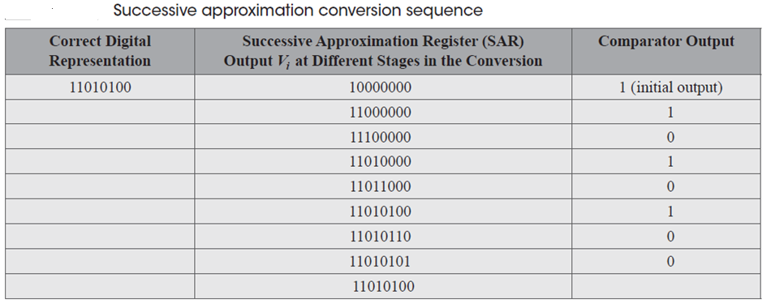
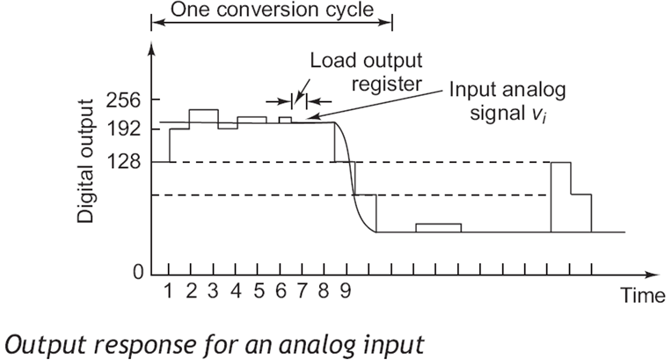

Slide 51
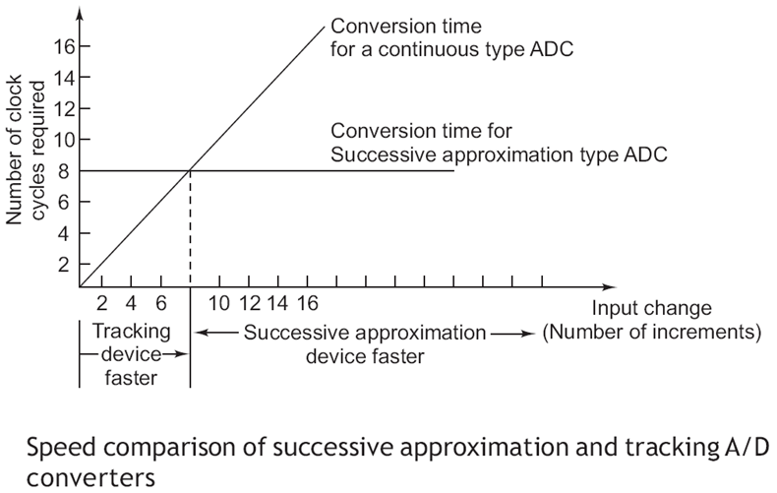
Successive Approximation Type A/D Converter

Slide 52
Advantages
For n bit ADC- Conversion time = n clock cycles
Conversion time is independent of amplitude of input signal
Disadvantages
The circuit is complex
The conversion time is longer than flash type of ADC
0809

Slide 53
An 8-bit successive approximation A/D converter is driven by a 2 MHz clock signal. Find the conversion time required.
The time for one clock pulse = 1 /2MHz = 0.5 microsec.
The time required to perform the calculation is the sum of (i) the time required for resetting SAR before performing the conversion, and (ii) the time required for performing the conversion. Therefore, the total number of clock pulses required for the conversion is given by (8 + 1 = 9 ) clock cycles = 9 * 0.5 microsec = 4.5 microsec.

Slide 54
Comparison
Type of ADC | Speed | Price | Noise Immunity | Conversion Time
Dual slope | ☹☹☹ | ☺☺ | ☺☺☺ | Vary (2*2^{n}) tclk
Successive approximation | ☺☺☺ | ☹ | ☹ | Constant No. of bits * tclk
Parallel / flash | ☺☺☺☺☺ | ☹☹☹☹☹ Not feasible for high resolution | ☹ | Constant Single tclk

